Slide 1

PRESENTATION
NUTRITIONAL VARIATION ACROSS FAST-FOOD RESTAURANTS
MARIYAM ASKHATKYZY
9 DECEMBER 2025
BSAN 360 – FINAL PROJECT

Slide 2

DATASET OVERVIEW
Dataset: Kaggle Fast Food Nutrition Dataset
Total observations: 515 menu items
Restaurants included: McDonald's, Burger King, Taco Bell, Subway, Sonic, Dairy Queen, Chick-fil-A, Arby's
Features analyzed:
Calories
Total fat
Sugar
Protein
Sodium
Total carbohydrates
Goal:
Understand whether nutritional values differ across restaurants and identify which nutrients predict calorie levels.
Primary source: Kaggle Fast Food Nutrition Dataset: https://www.kaggle.com/datasets/ulrikthygepedersen/fastfood-nutrition?resource=download

Slide 3

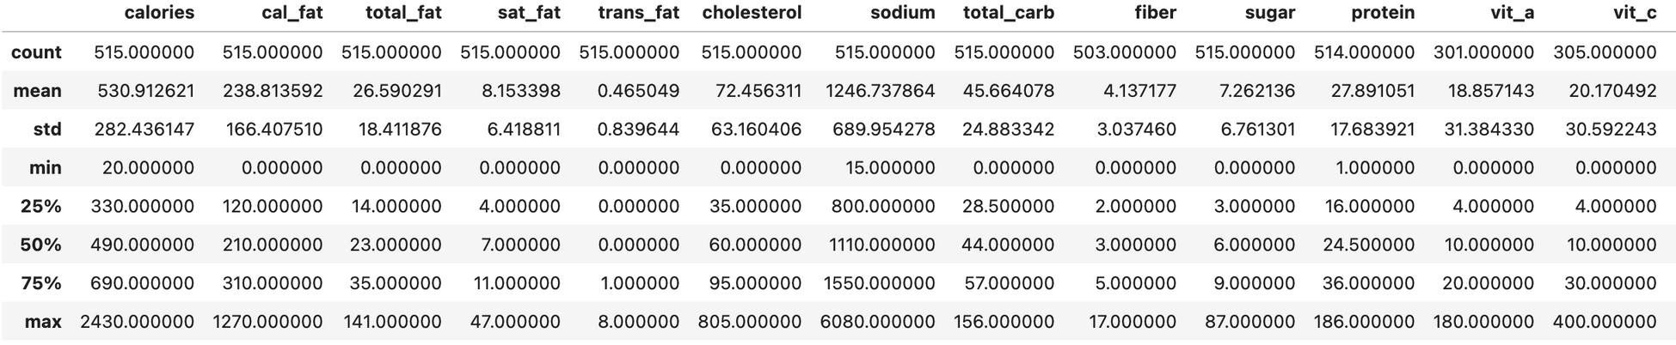
DATA & VARIABLES
Observations: 515 menu items
Restaurants: Arby’s, Burger King, Chick-fil-A, Dairy Queen, McDonald’s, Sonic, Subway, Taco Bell
Main numeric variables used:
calories – total calories per item
total fat, total carb, protein, sugar, sodium
Data prep:
Removed/handled a few missing values (mainly protein / fiber).
Created clean columns and checked ranges for outliers.
Protein and fiber had ~10 missing values which were removed for analysis.
Approximately 10 rows with missing protein or fiber values were removed to ensure accurate statistical analysis

Slide 4





BACKGROUND & MOTIVATION
FAST FOOD IS A BIG PART OF EVERYDAY EATING, BUT NUTRITIONAL DIFFERENCES BETWEEN CHAINS ARE NOT ALWAYS OBVIOUS.
USED A DATASET OF 515 MENU ITEMS FROM 8 US FAST FOOD CHAINS (TACO BELL, SUBWAY, MCDONALD’S, BURGER KING, SONIC, ARBY’S, DAIRY QUEEN, CHICK-FIL-A).
THE GOAL IS TO UNDERSTAND HOW CALORIES AND SUGAR DIFFER BY RESTAURANT AND WHAT DRIVES TOTAL CALORIES IN MENU ITEMS.
THIS ANALYSIS CAN HELP WITH MENU PLANNING, MARKETING, AND CONSUMER TRANSPARENCY.

Slide 5
RESEARCH QUESTIONS
Do calorie, fat, and sugar levels significantly differ across restaurants?
Which restaurants are nutritionally distinct based on Tukey pairwise comparisons?
How strongly does total fat, sugar, protein, sodium, and carbs predict calorie levels?
Is there a relationship between fat and sugar content across menu items?
Focus is exploratory: understanding patterns, not making causal claims.

Slide 6

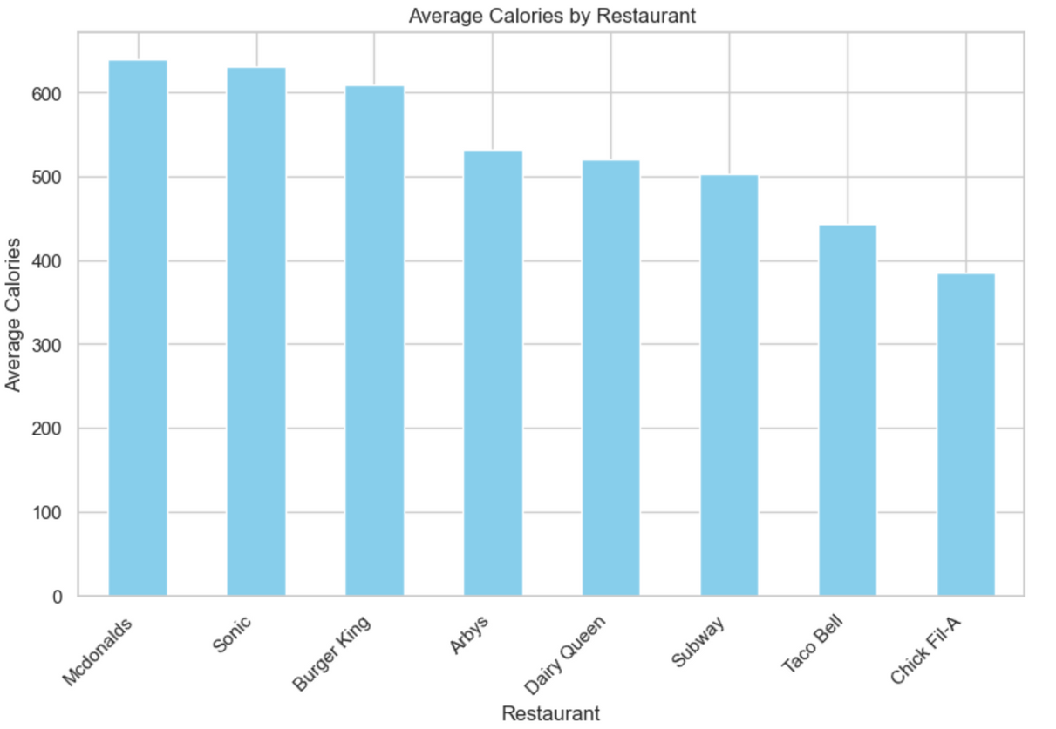
DO CALORIES DIFFER BY RESTAURANT?
I ran a one-way ANOVA with calories as the response and restaurant as the group.
Result: F ≈ 6.08, p ≈ 7.7e-07 (< 0.05).
Interpretation: There is a statistically significant difference in average calories across restaurants.
Some chains tend to have consistently higher, or lower, calorie items than others.
Sonic and Mcdonald’s have the highest average calories.
Chick-fil-A consistently has the lowest average calories.
A Tukey HSD test was also applied to identify which restaurant pairs differ significantly.

Slide 7

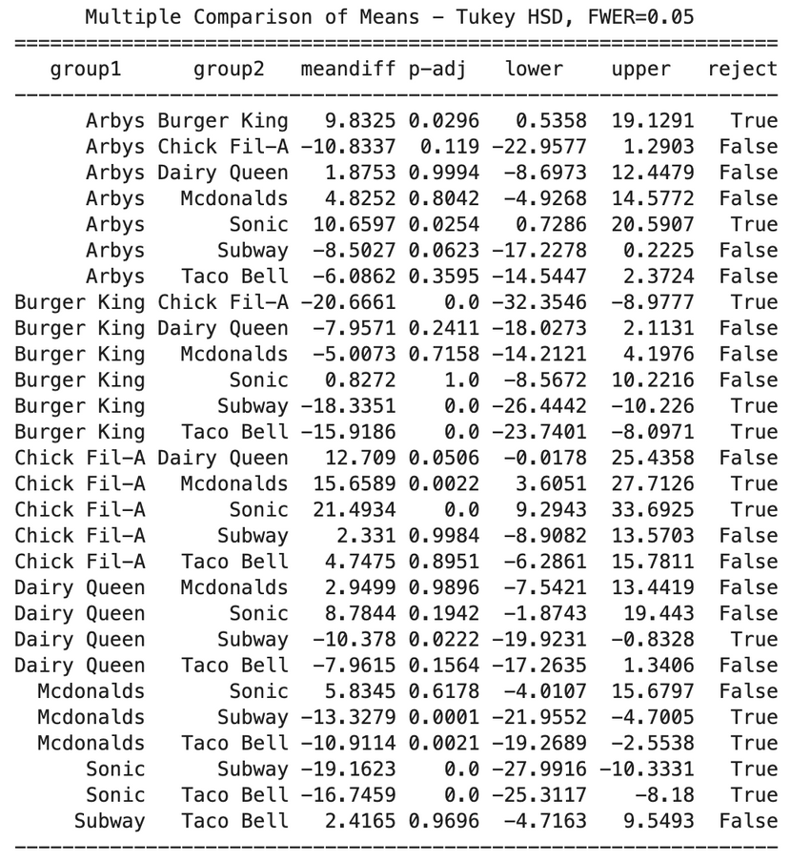
FAT BY RESTAURANT
ANOVA confirmed that total fat levels differ significantly across restaurants
(F = 14.20, p < 0.0001).
A follow-up Tukey test shows which restaurants differ from each other:
Chick-fil-A shows higher fat values than many chains, but the difference is not always statistically significant depending on the pair.
Subway shows the lowest fat levels, significantly lower than Burger King, McDonald’s, Sonic, and Taco Bell.
Taco Bell and Sonic also have noticeably higher-fat items compared to several other restaurants.
Overall, the results reveal clear nutritional segmentation among fast-food chains based on total fat content.

Slide 8
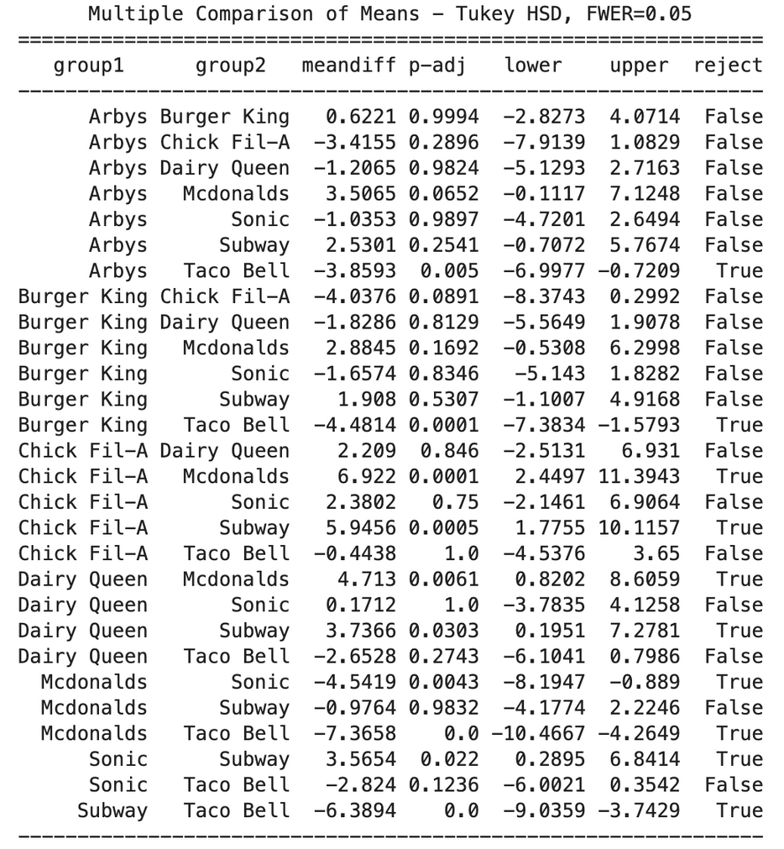
SUGAR BY RESTAURANT
I ran a one-way ANOVA for sugar by restaurant.
Result: F ≈ 12.43, p ≈ 1.0e-14 → highly significant differences in mean sugar by chain.
Then I applied a Tukey post-hoc test to see which specific restaurant pairs differ.
The Tukey test shows multiple significant pairwise differences, especially:
Pairs involving Taco Bell and Subway,
Pairs involving McDonald’s and Dairy Queen,
Some differences between McDonald’s vs Sonic, and Subway vs Sonic.
Taco Bell and Subway differ in sugar levels by the largest margin (≈6.38g, p < 0.001).
Interpretation: Sugar content is not uniform across chains; some brands consistently offer items with more sugar content than others.

Slide 9
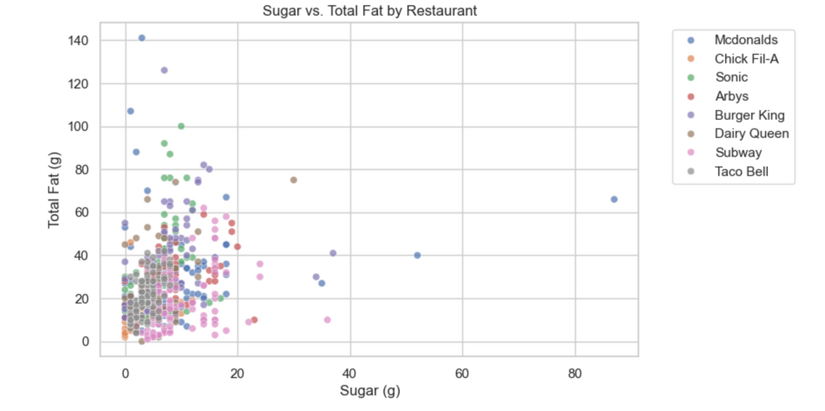
RELATIONSHIP BETWEEN FAT AND SUGAR
The correlation between sugar content and total fat is weak (r = 0.26).
r = 0.26 indicates a weak positive correlation.
This means sugar and fat do not strongly increase together. Some items are high in fat but low in sugar (e.g., fried foods), while others are high in sugar but low in fat (e.g., desserts or drinks).
The scatterplot visually confirms this weak relationship, showing a wide spread of points rather than a clear upward trend.

Slide 10

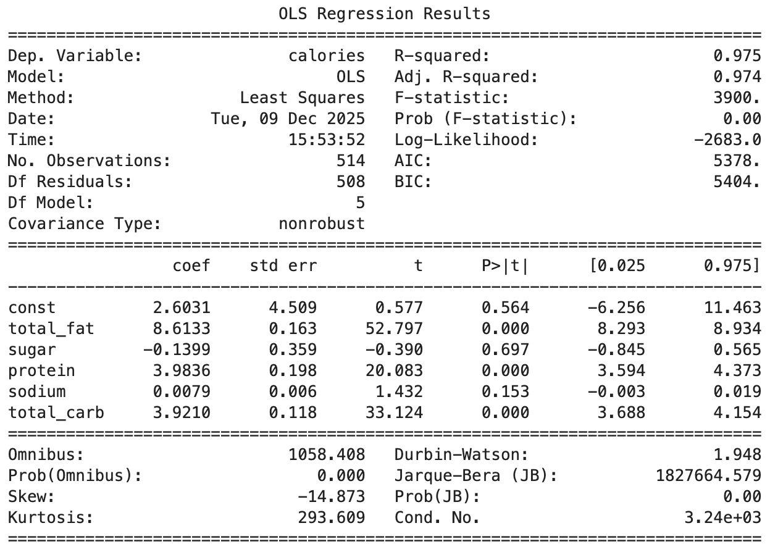
REGRESSION: PREDICTING CALORIES
I built an OLS linear regression model using nutrients to predict calories.
Adjusted R² ≈ 0.974 → the model explains about 97% of the variation in calories.
Key findings:
total fat, protein, and total carbs have positive and statistically significant coefficients.
sugar and sodium are not significant once fat, carbs, and protein are in the model.
Interpretation: Total calories are mainly driven by fat, carbohydrates, and protein content, which makes sense nutritionally.
This model is very accurate for prediction of calories based on the main nutrient information.
Multicollinearity may be present (condition number ≈ 3240), which is expected because nutritional variables are naturally correlated.

Slide 11

CONCLUSION
There are statistically significant differences in calories, total fat, and sugar across fast-food restaurants (ANOVA, p < 0.001 for all three nutrients).
Tukey’s HSD shows clear nutritional segmentation:
Chick-fil-A and Taco Bell frequently appear in higher-fat or higher-sugar segments.
Subway consistently shows significantly lower total fat than several competitors.
McDonald’s and Burger King exhibit higher sugar in multiple pairwise comparisons.
The relationship between sugar and total fat is weak but positive (Pearson r ≈ 0.26), meaning items slightly higher in sugar also tend to have somewhat more fat.
Overall, the dataset reveals meaningful nutritional differences that customers and businesses can use for informed decisions.

Slide 12



BUSINESS IMPLICATIONS & RECOMMENDATIONS
FOR CONSUMERS
NUTRITIONAL VALUES DIFFER DRAMATICALLY BY CHAIN. CUSTOMERS WHO PRIORITIZE HEALTH SHOULD PREFER CHAINS WITH CONSISTENTLY LOWER CALORIES AND FAT (E.G., SUBWAY FOR SANDWICHES).
MENU ITEMS FROM TACO BELL, CHICK-FIL-A, AND MCDONALD’S MAY REQUIRE PORTION AWARENESS DUE TO HIGHER FAT OR SUGAR LEVELS.
FOR RESTAURANTS
RESTAURANTS WITH HIGHER FAT/SUGAR PROFILES CAN:
INTRODUCE LIGHTER OR REFORMULATED MENU ITEMS TO MEET DEMAND FOR HEALTHIER OPTIONS.
IMPROVE TRANSPARENCY WITH CLEAR NUTRITIONAL LABELING.
USE THIS DATA TO BENCHMARK AGAINST COMPETITORS.
FOR PUBLIC HEALTH
RESULTS SUPPORT THE USEFULNESS OF NUTRITIONAL REGULATION (MENU LABELING), AS MENU ITEMS VARY MORE WIDELY THAN MOST CONSUMERS ASSUME.

Slide 13

THANK YOU!
FOR YOUR ATTENTION

